Slide 1


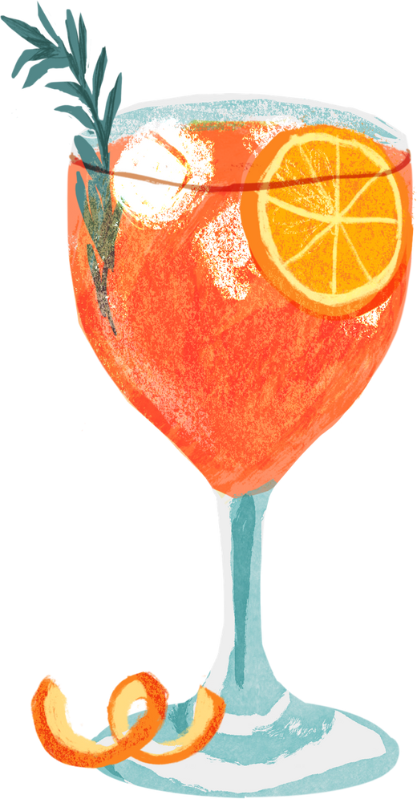
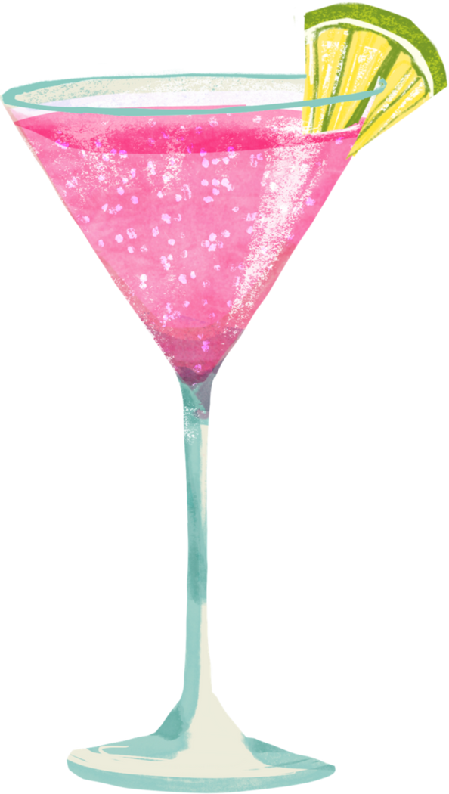
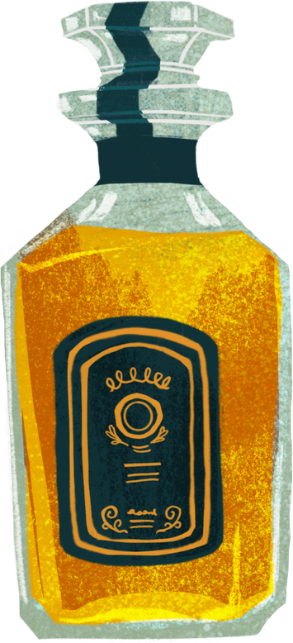
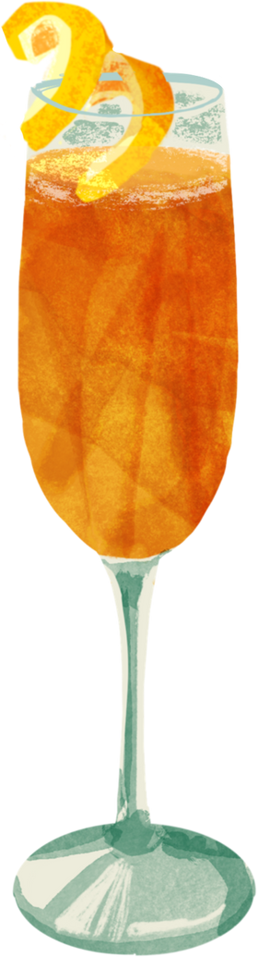
Kaggleton5
PUB PERSONA: EXPLORING BAR CUSTOMER ARCHETYPES
excessive alcohol consumption is harmful to your health

Slide 2

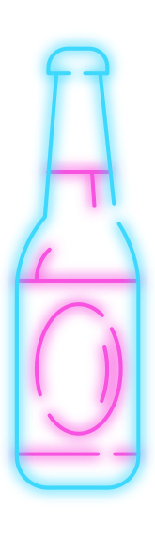
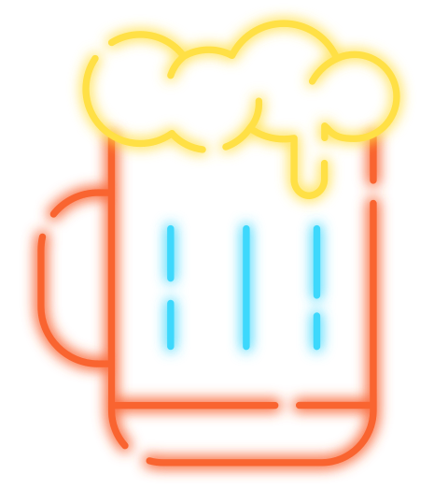
Some insights #1
Gender
Age
Income
THE MAJORITY OF BAR VISITORS ARE MALE
THE BAR IS KINDA POPULAR WITH YOUTH. ELDERLY/MIDDLE-AGED CUSTOMERS ARE RARER
THE YOUNGEST PERSON THERE IS 16
THE INCOME FALLS INTO 3 CAREGORIES: 1, 3, 5. THE LARGEST INCOME GROUP IS 3
Beer Price Sensitivity
Number of Friends
THE LARGER IT IS, THE RARER (VALUES 1, 2, 3 ARE THE MOST POPULAR ONES)
PEOPLE RARELY ATTEND THIS BAR ON THEIR OWN
THE MOST POPULAR GROUP CHOICE IS 3 PEOPLE

Slide 3
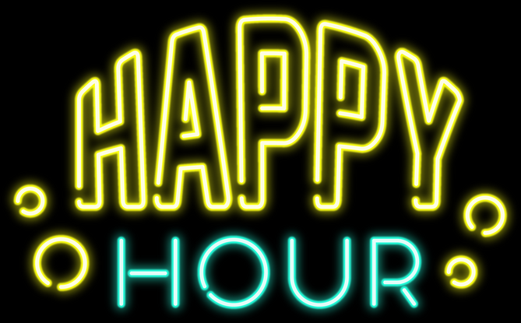



Some insights #2
Dance Frequency Score
Frequency of Purchase
Time of Purchase
PEOPLE WITH TIME OF PURCHASE 2 HAVE THE HIGHEST SOCIAL ACTIVITY SCORE (3 - THE LOWEST)
HOWEVER, PEOPLE WITH TIME OF PURCHASE 3 BUY THINGS MORE OFTEN
THE MAJORITY OF GROUPS HAVE 1-2, SUGGESTING IT’S NOT A DANCEY PLACE
PEOPLE WITH PURCHASE FREQUENCY 1 ARE MUCH MORE SOCIAL AND DANCE MORE

Slide 4

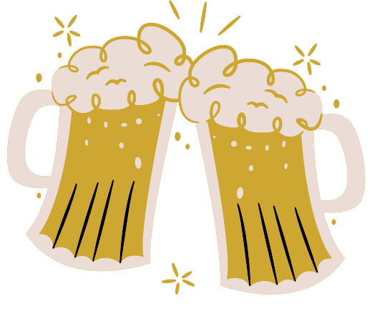
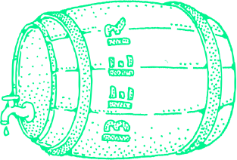
Some insights #3
Social Activity Score
Aggression Score
Noise Generation Level
PEOPLE CAN BE DIVIDED INTO 2 GROUPS: THOSE WHO MOSTLY DRINK AND THOSE WHO MOSTLY DANCE
MALES TEND TO BE MORE AGGRESSIVE THAN FEMALES
MALES ARE USUALLY LOUDER THAN FEMALES

Slide 5


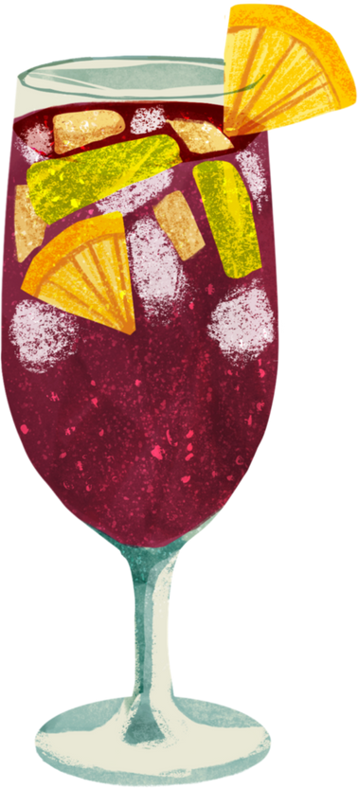
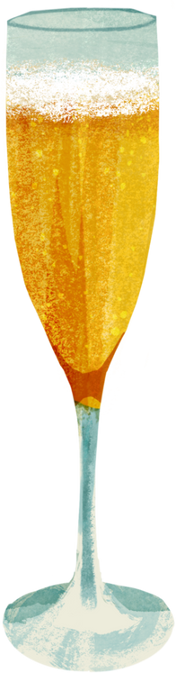
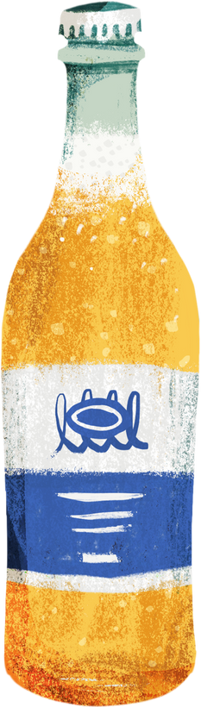
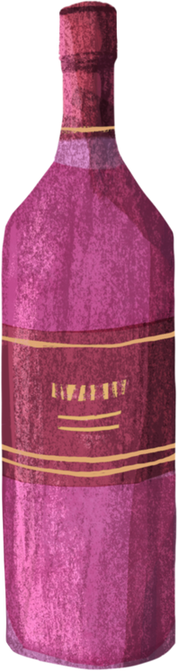
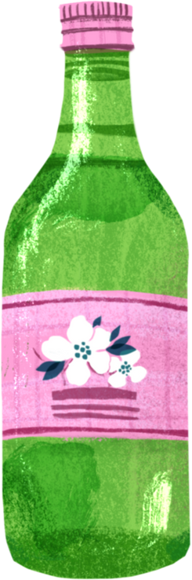
Models we tried
Used PCA (and also tried T-SNE) before all that stuff below
K-MEANS
EM-METHOD
AGGLOMERATIVE CLUSTERING
DBSCAN
HDBSCAN
FOUND 6 CLUSTERS

Slide 6
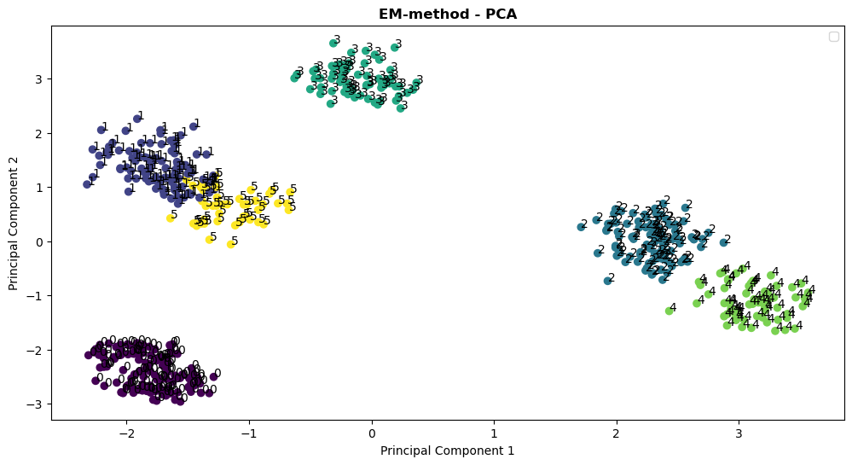
EM-METHOD
n_components=6

Slide 7
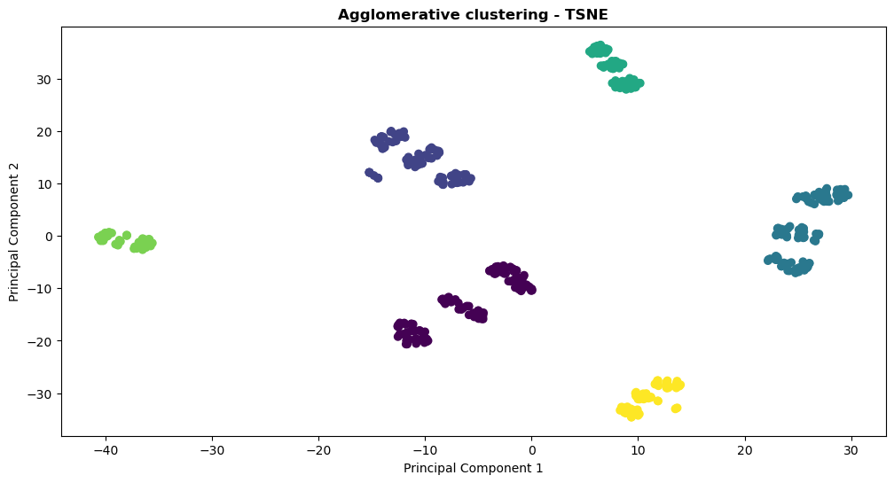
Agglomerative clustering
n_clusters=6

Slide 8
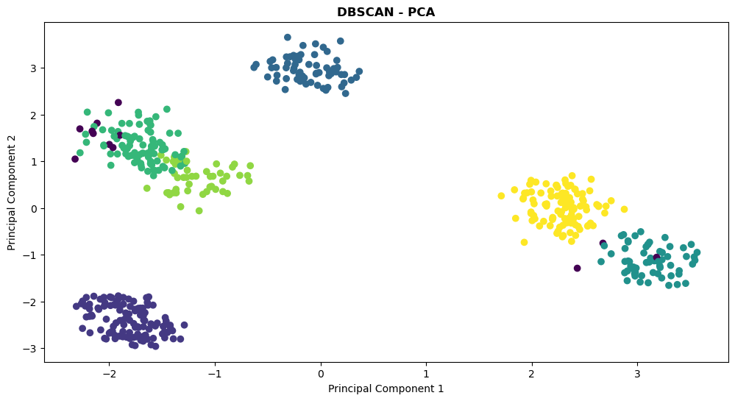
DBSCAN

Slide 9
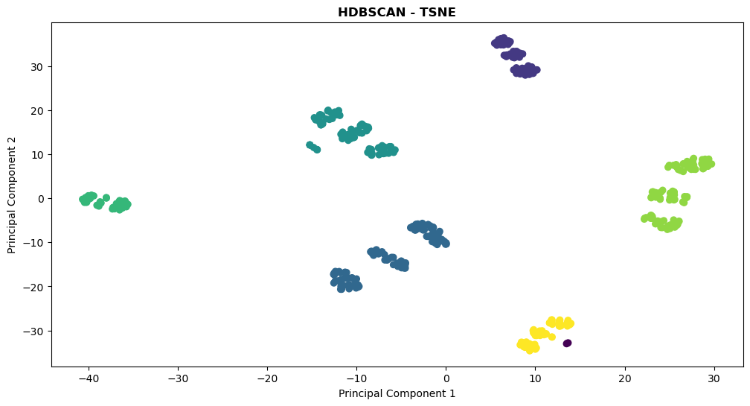
HDBSCAN

Slide 10
ANOVA
There are NO STATISTICALLY SIGNIFICANT DIFFERENCES in the average value between clusters of the following feature: Flirting Score (p-value: 0.791).
The inf value might indicate ZERO VARIANCE IN ONE OF THE GROUPS: Average Income, Frequency of Purchase, Time of Purchase.
Other features have STATISTICALLY SIGNIFICANT DIFFERENCES in the average value between clusters

Slide 11
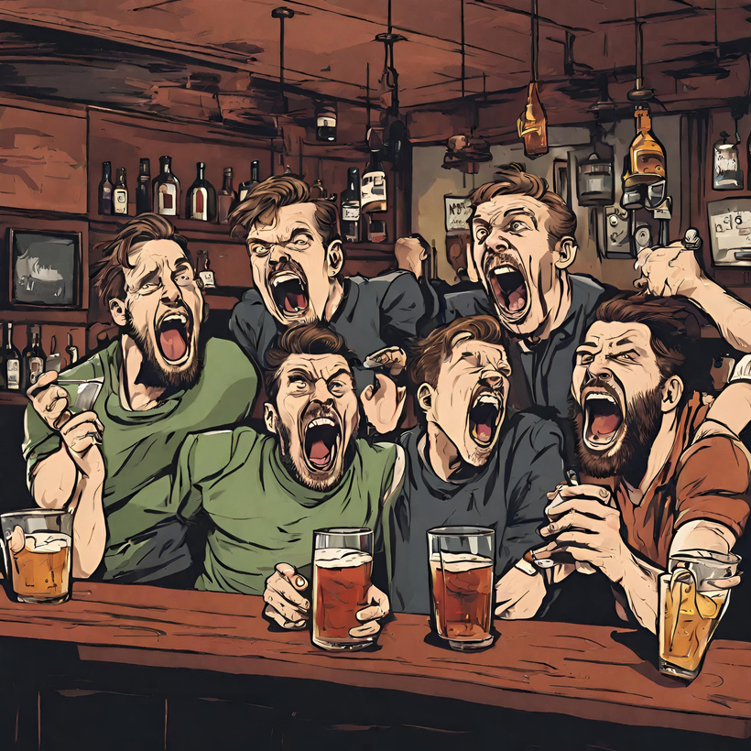
CLUSTER 1
‘LIVELY LADS’ (118 individ.)
males aged 20-29
high aggression and noise generation level
high social activity
average income
high brand loyalty

Slide 12
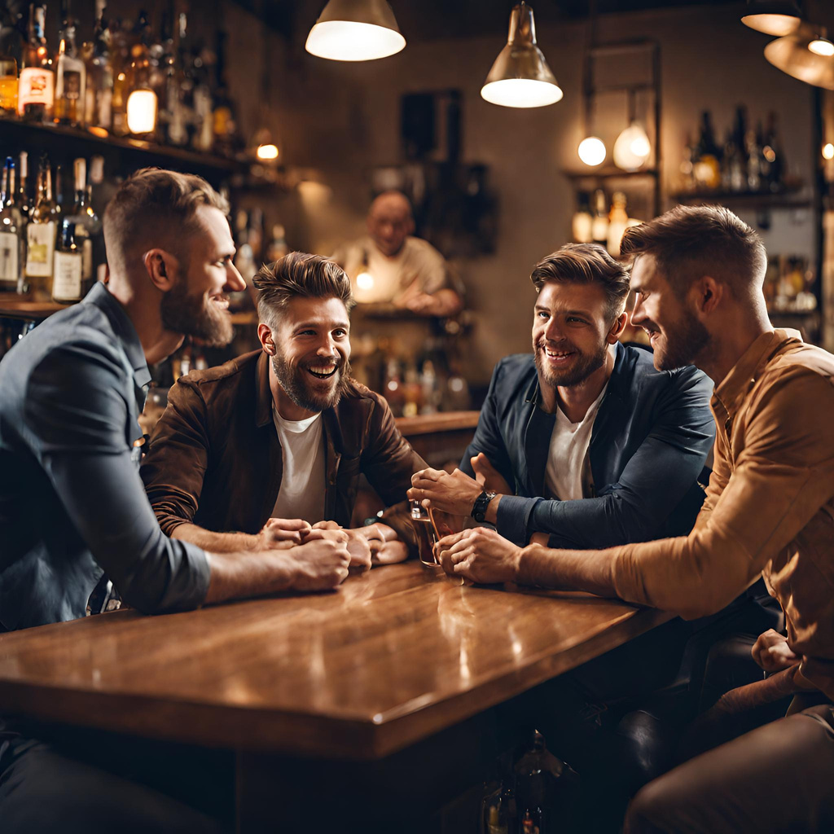
CLUSTER 2
"The Mid-Age Money Brew Crew“
(98 individ.)
males aged 32-49
high income and social activity
low noise and aggression

Slide 13
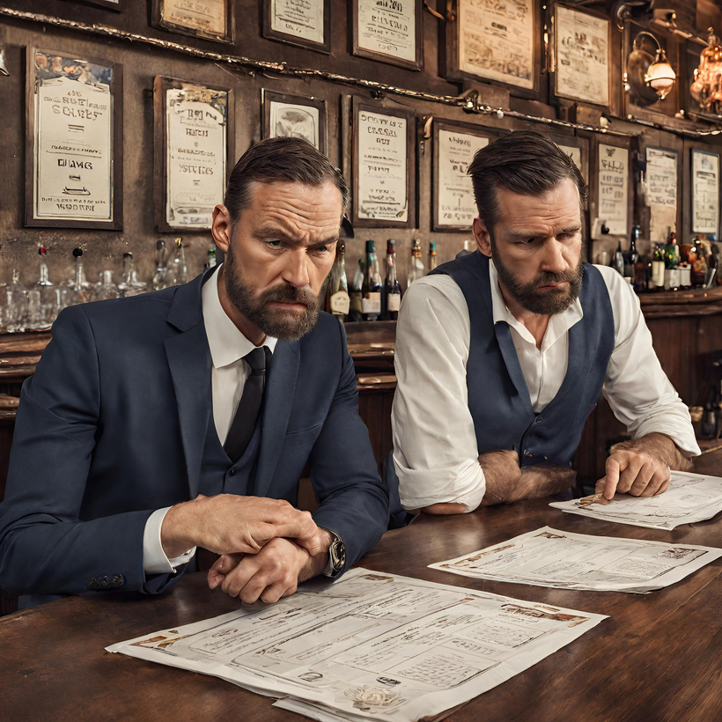
CLUSTER 3
‘The Equilibrium Extraordinaire’
(108 individ.)
males aged 25-31
dissatisfied with beer prices
average income and beer sensitivity
everything's kinda balanced, no extremes
low noise generation level and flirting score

Slide 14
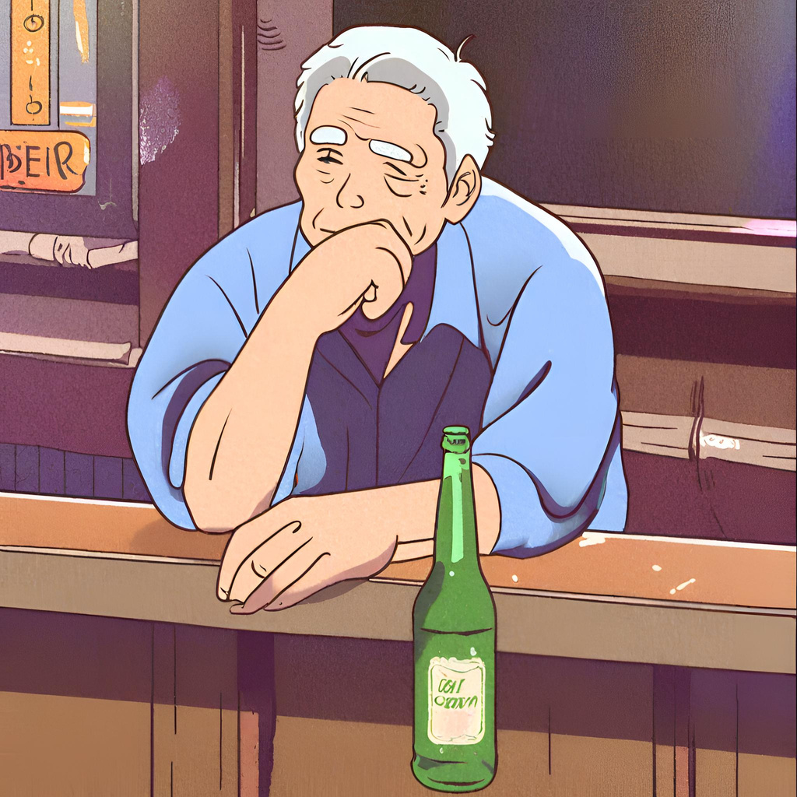
CLUSTER 4
‘The Solo Sippers Society’
(64 individ.)
males aged 65-74
low income
low number of friends (practically none)
relatively quiet
high brand loyalty

Slide 15
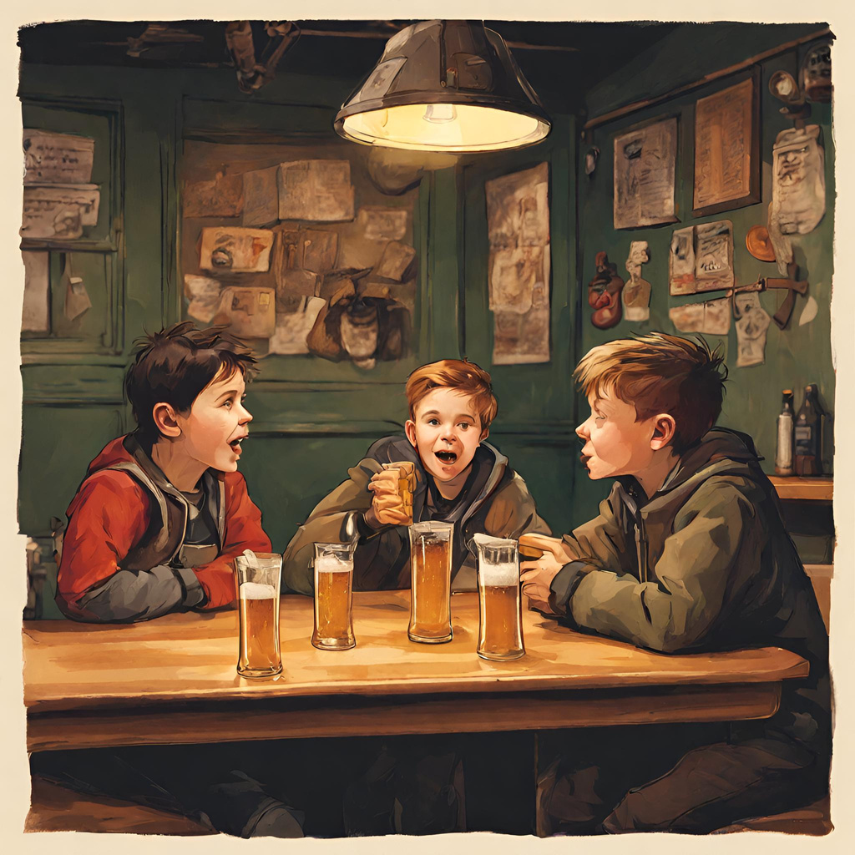
CLUSTER 5
‘School ditchers’
(64 individ.)
males aged 16-17
little to no income
high groups of friends
high noise generation
very high beer price sensitivity

Slide 16
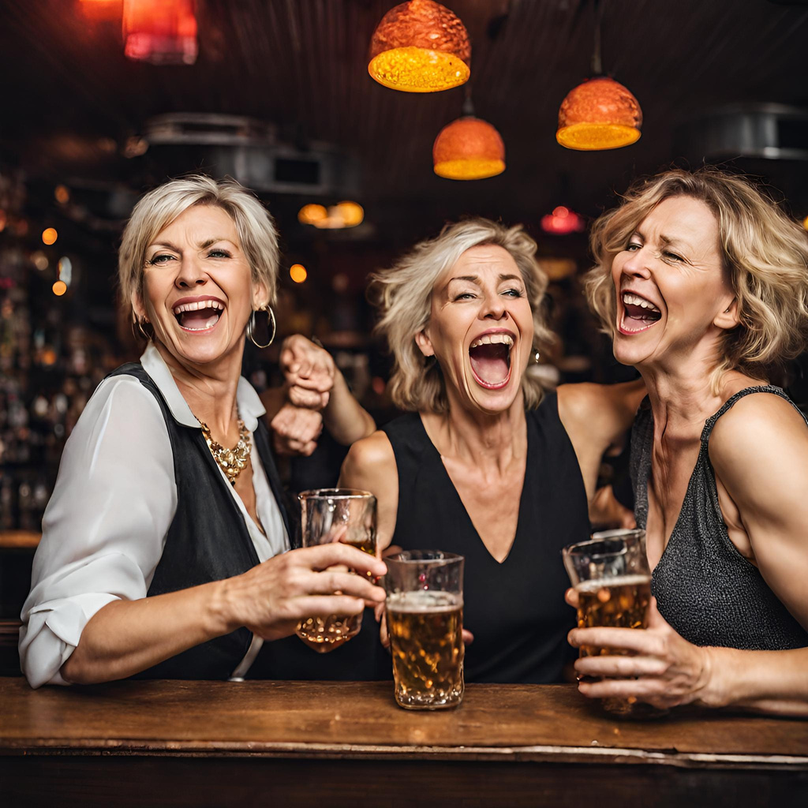
CLUSTER 6
"The Dancing Divas of Midlife“
(48 individ.)
females aged 38-48
average income and beer price sensitivity
high social activity, noise generation level and a ton of dancing

Slide 17




Thank you!

